Slide 1
PHS 2000 Econometric Methods 2026 Lecture 5 ITS/DID
Maggie McConnell
Department of Global Health and Population
Harvard T. H. Chan School of Public Health

Slide 2
Plan of presentation
Wrap-up ITS/Controlled ITS
Difference in Differences model
Example
Clustering and standard errors
Contrasting difference in differences approach with interrupted time series

Slide 3
Controlled interrupted time series (CITS)
What kind of confounding do we worry about with ITS?
Given worries about confounding over time → would be nice to have control regions
These areas did not get the treatment and should not see a treatment effect
If we do see “treatment” effect in control areas, suggests the “intervention” effect due to some common factor affecting both the treated & control areas
Assume we have a second region/hospital that did not get the intervention. This is the control group.
Counterfactual – jump and change in trend in the control group would have been the same as in the treatment group without treatment

Slide 4
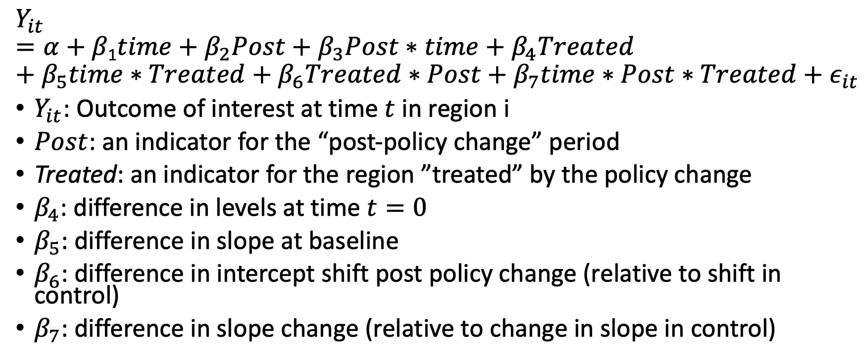
Controlled Interrupted Time Series
$$Y_{it}=α+β\text{1}time+β_{2}Post+β_{3}Post∗time+β_{4}Treated+{β_{5}time∗Treated+β_{6}Treated∗Post+β_{7}time∗Post∗Treated+ε}_{it}$$
$Y_{it}$: Outcome of interest at time $t$ in region i
$Post$: an indicator for the “post-policy change” period
Treated: an indicator for the region ”treated” by the policy change
$β_{4}$: difference in levels at time $t=0$
$β_{5}$: difference in slope at baseline
$β_{6}$: difference in intercept shift post policy change (relative to shift in control)
$β_{7}$: difference in slope change (relative to change in slope in control)

Slide 5
Challenges with Controlled ITS
Control group does not need to be identical to treatment group in the pre-intervention period
Different intercept
Different slope
Counterfactual: changes from trend seen in the control group in the post intervention period would have occurred in the intervention group without the intervention
Less convincing if the control group is dissimilar to the treatment group
We have to really believe our modeling of trends in the control group

Slide 6
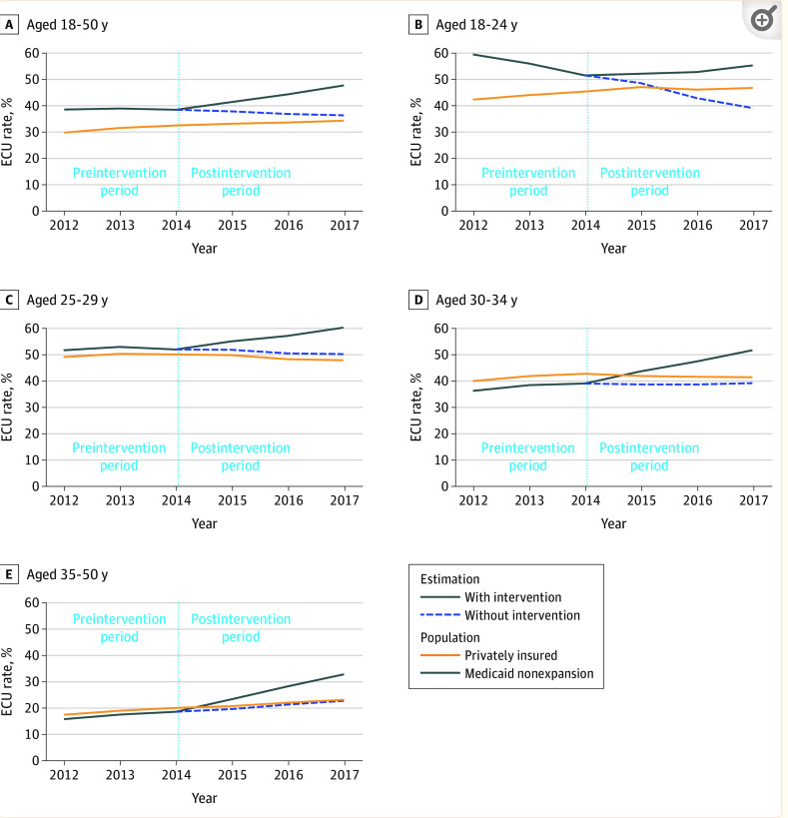
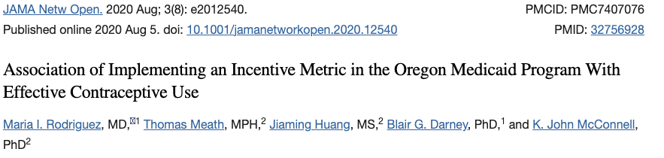
CITS Example –Contraception
Policy change: Financial incentives for effective contraception in Medicaid
- why might we want a comparison group?
Control group: privately insured
How plausible is the assumption we need for CITS to be valid?
- control group trends would be expected to continue for treatment group without intervention

Slide 7
Summary: Interrupted time series
ITS analysis offers an interesting empirical approach to assessing policy impact when we have routinely collected temporal data
The main identification assumption is that the timing of the reform is not correlated with other things affecting the outcome and observed trends in the data would have continued without the intervention
ITS works best if the policy start is clearly defined and impact is immediate (or predictably delayed) and large

Slide 8
Summary: Interrupted time series
CITS can offer a more robust alternative that controls for confounding changes that happened at the same time
Requires a credible control group that experienced the same confounding changes but not the treatment we are interested in
This is not always easy to find
We will discuss alternative strategy for finding a control group (synthetic control) tomorrow

Slide 9
Difference-in-Differences logic – simplest case
Suppose we have two areas that are similar at baseline and one gets the intervention (treatment area) and one does not (control area)
If the areas are similar, we could argue that counterfactual is that the increase over baseline in the treated areas would have been similar to the increase over baseline in the control area without intervention
Notice this is similar to the logic of controlled ITS

Slide 10
Difference-in-differences estimator:
Estimate difference in outcome between post- and pre-intervention levels in program areas (“treated”)
Estimate difference in outcome between post- and pre-intervention levels in non-program areas (“controls”)
Estimate difference in changes in outcome levels between treated and controls

Slide 11
Difference in difference
B
DD: change in treated group relative to change in control
 | Treatment | Control
Before | A | C
After | B | D
Change | B-A | D-C
DD | ( B-A ) – ( D-C )
B-A: change in treated group
A
D
D-C: change in control group
C
Pre
Post
Did the outcomes in the treated areas improve by more than in the control areas?
DD = ( change in treatment ) – ( change in control ) = ( Treat^{post} - Treat^{pre} ) – (Control^{post} - Control^{pre} )

Slide 12
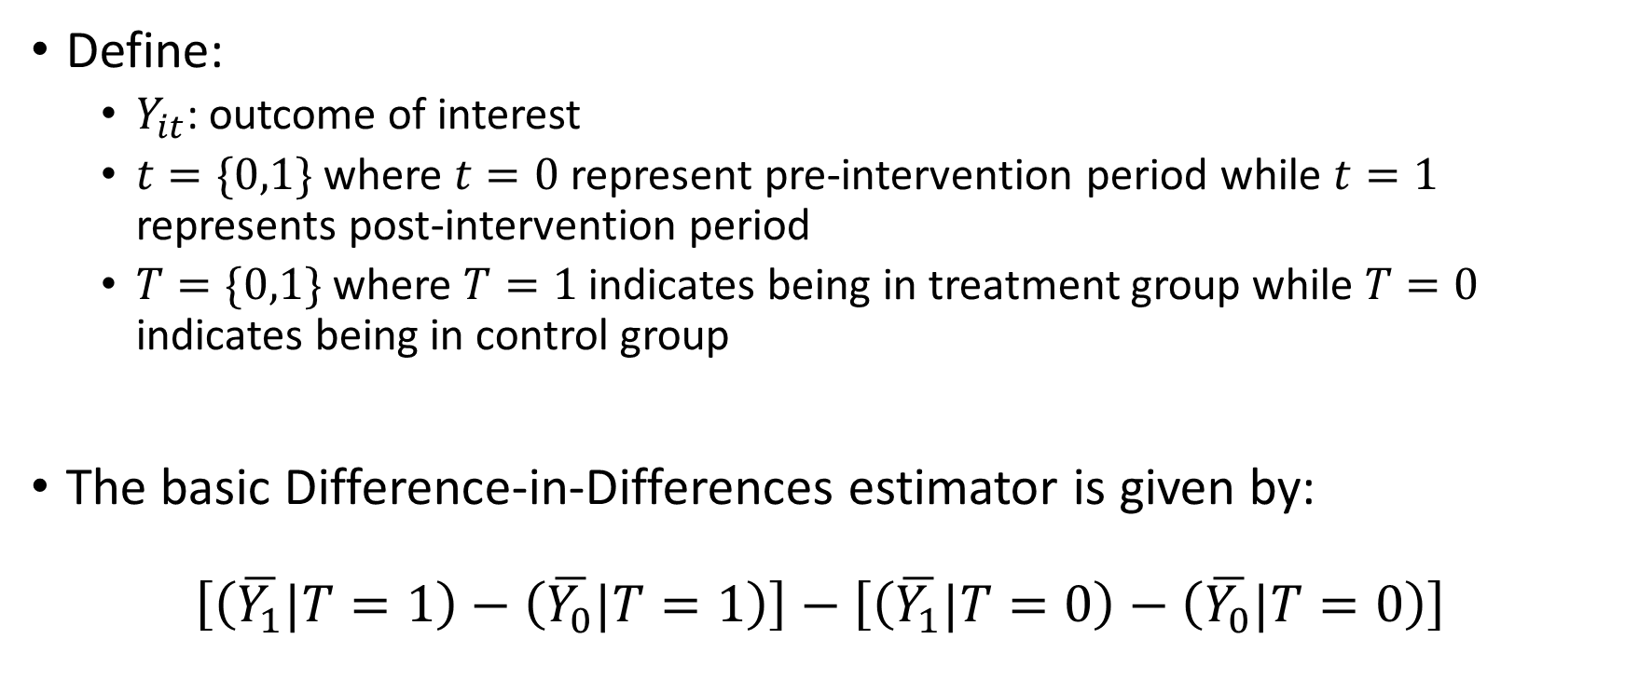
Difference-in-Differences estimator: Notation
Define:
$Y_{it}$: outcome of interest
$t=\{0,1\}$ where $t=0$ represent pre-intervention period while $t=1$ represents post-intervention period
$T=\{0,1\}$ where $T=1$ indicates being in treatment group while $T=0$ indicates being in control group
The basic Difference-in-Differences estimator is given by:
$$\left[\left(\overline{Y_{1}}|T=1\right)−\left(\overline{Y_{0}}|T=1\right)\right]−\left[\left(\overline{Y_{1}}|T=0\right)−\left(\overline{Y_{0}}|T=0\right)\right]$$
=Dif (over time) in treatment group – Dif (over time) in control group

Slide 13
Difference-in-Differences logic
The real causal question is: How would the “treated” have done without the treatment?
Differences in differences assumes the control group can tell us what would have happened in the post intervention period in the treatment group with no intervention
The counterfactual is that if the treatment group had not got the treatment, the change we would have seen is the change observed in the control group over the same period

Slide 14

Simplest difference in difference regression
The simplest difference-in-difference specification is a 2 period (pre, post) and two group (treated, control) specification:
$$Y_{it}=α+β{Treated}_{i}+γ{Post}_{t}+δ\left({Treated}_{i}∗{Post}_{t}\right)+ε_{it}$$

Slide 15
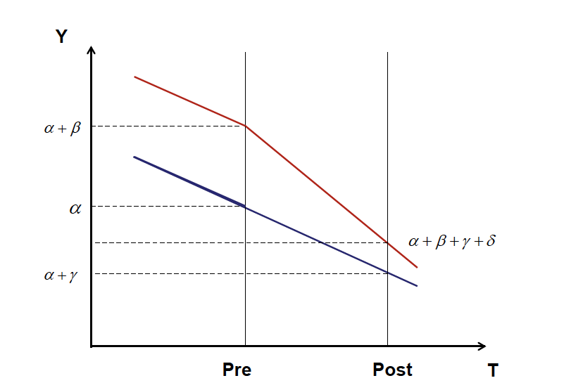
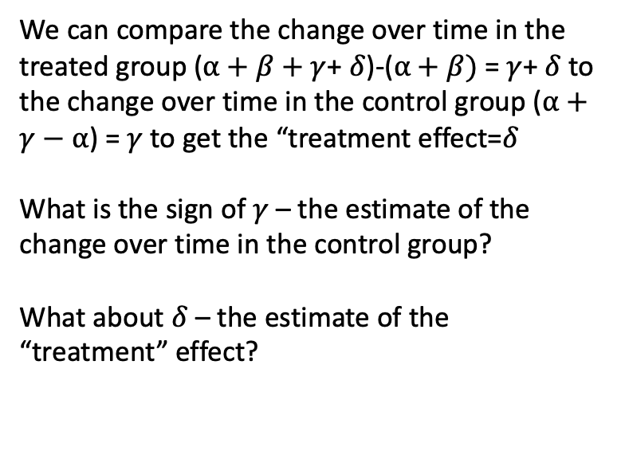
Difference in difference – another example
We can compare the change over time in the treated group ($α+β+γ$+ $δ$)-($α+β)$ = $γ$+ $δ$to the change over time in the control group ($α+γ−$ $α$) = $γ$to get the “treatment effect=$δ$
What is the sign of $γ$ – the estimate of the change over time in the control group?
What about $δ$ – the estimate of the “treatment” effect?

Slide 16
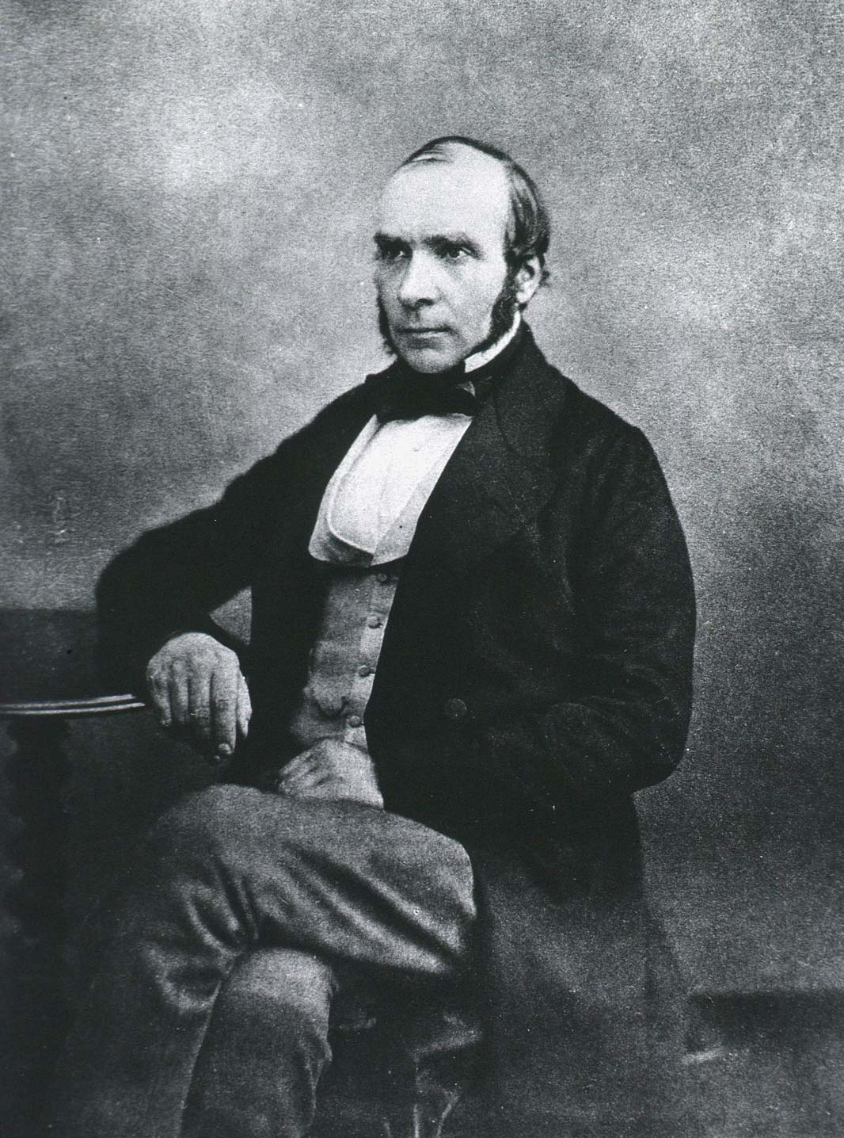
Difference in differences is a classic strategy for generating public health evidence

Slide 17
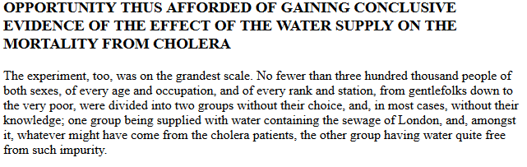
John Snow DiD analysis
London had cholera outbreaks in 1849 and 1853
Two water companies: Lambeth Waterworks & Southwark and Vauxhall Water Co.
Both got their water from the Thames river
In 1852 Lambeth moved its water intake to the Thames Ditton river, which is higher upstream
Source: John Snow 1855 “On the Mode of Communication of Cholera“

Slide 18
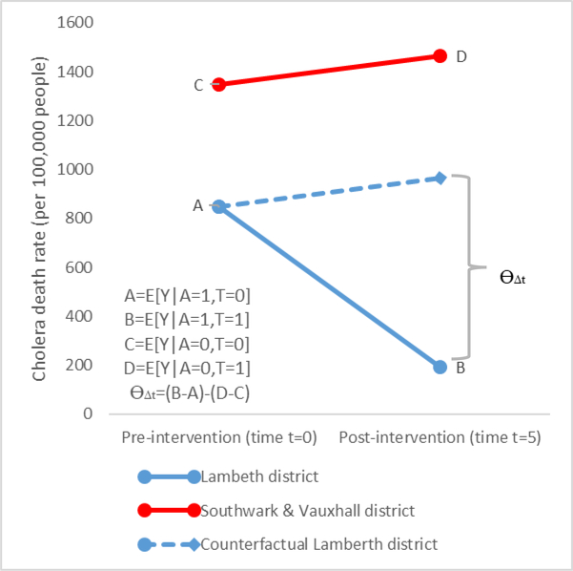
Difference-in-Difference in the Time of Cholera: a Gentle Introduction for Epidemiologists
Variable A indicates different water sources
Variable T indicates measurement takes place before and after the change of water source
Y is a death from cholera

Slide 19
Simplest difference in difference case
We are comparing 4 data points: control pre, control post, treated pre, treated post
The difference between control pre and post must be a good counterfactual for what would have happened to the treatment group without treatment
But what if in the control district there was a hand-washing campaign at the same time the treatment group changed its water source
Do we find the counterfactual assumption plausible in this case?

Slide 20
Another example – rollout of health insurance
Assume you want to evaluate the effect of a recently introduced health insurance on health seeking behavior at the individual level
Further assume that the health insurance was piloted only in 3 out of 25 districts of the respective region of interest
You have two cross-sectional health surveys: one before the introduction of the insurance scheme, and one after. Both surveys contain information on:
Total number of visits at health center
Total average health cost per person

Slide 21
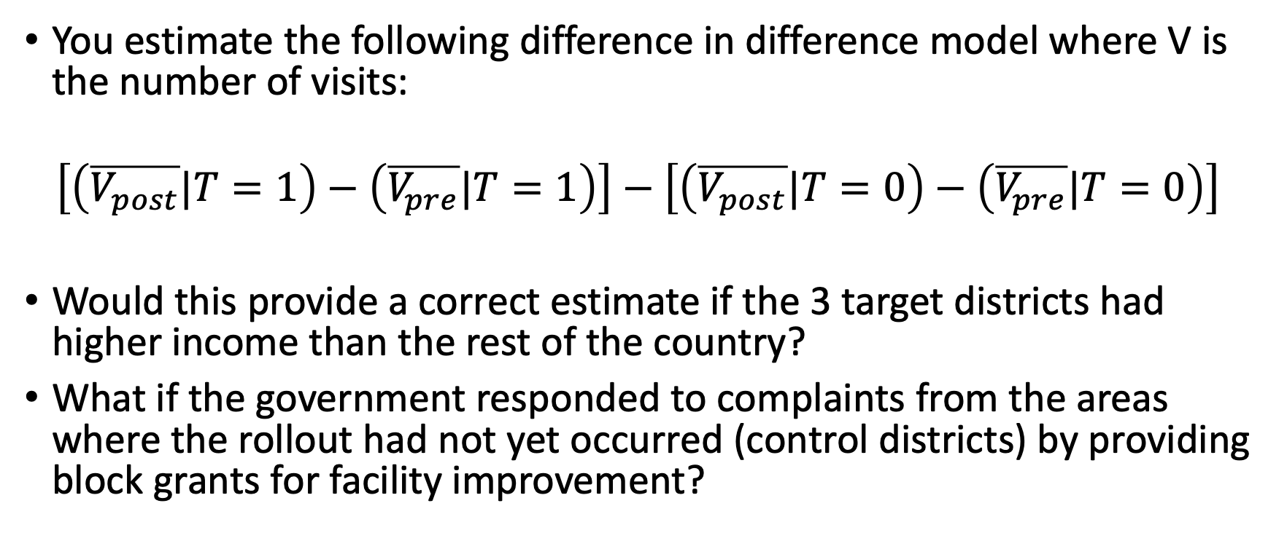
Example – rollout of health insurance
You estimate the following difference in difference model where V is the number of visits:
$$\left[\left(\overline{V_{post}}|T=1\right)−\left(\overline{V_{pre}}|T=1\right)\right]−\left[\left(\overline{V_{post}}|T=0\right)−\left(\overline{V_{pre}}|T=0\right)\right]$$
Would this provide a correct estimate if the 3 target districts had higher income than the rest of the country?
What if the government responded to complaints from the areas where the rollout had not yet occurred (control districts) by providing block grants for facility improvement?

Slide 22
Multiple groups and time periods
We need at least two groups – treatment and control – and two time periods – pre and post – to get a difference-in-differences estimator
Essentially at least four observations
However -- need more data for inference (valid standard errors)
With more data we can strengthen our belief in the assumptions that make DiD valid
Hard for one district to make a convincing control group → averaging across many districts together means the counterfactual assumption is more plausible
With just one observation from the pre-period, harder to know that we haven’t gotten noise → more pre-period data allows better modeling of changes over time
DID is a flexible methodology we can extend in many ways
For example, we can include two post periods – an initial period of “transition” and a period where policy is fully implemented

Slide 23
Detour: Panel data
In ITS approaches, we are modeling trends using (often linear) functions, assumes outcomes follow a predictable function
We are typically comparing 1 treatment group and 1 control group – single trend for each
DiD approaches instead exploit richer (often individual) level panel data – where we have repeated observations of the same units over time
Can accommodate settings where there are many implementing groups (states, regions, etc) and many potential control groups (states, regions, etc)
Can give us much more power to detect responses to policy outcomes
Can allow for more flexible modeling of what is happening at different points of time and in different location

Slide 24
Detour – Panel data
State | Person | Year | Age | Married | Health spending | Policy
1 | 1 | 1990 | 22 | 0 | 30,129 | 0
1 | 1 | 1992 | 24 | 0 | 31,128 | 0
1 | 1 | 1994 | 26 | 0 | 25,876 | 1
1 | 2 | 1990 | 38 | 1 | 41,034 | 0
1 | 2 | 1992 | 40 | 1 | 42,308 | 0
1 | 2 | 1994 | 42 | 1 | 24,506 | 1
1 | 3 | 1990 | 25 | 0 | 32,556 | 0
1 | 3 | 1992 | 27 | 1 | 34,599 | 0
1 | 3 | 1994 | 29 | 1 | 33,677 | 1
2 | 1 | 1990 | 24 | 0 | 130,129 | 0
2 | 1 | 1992 | 26 | 0 | 131,128 | 1
2 | 1 | 1994 | 28 | 1 | 130,876 | 1
2 | 2 | 1990 | 40 | 1 | 141,034 | 0
2 | 2 | 1992 | 42 | 0 | 142,308 | 1
2 | 2 | 1994 | 46 | 0 | 124,506 | 1
2 | 3 | 1990 | 27 | 0 | 132,556 | 0
2 | 3 | 1992 | 29 | 0 | 134,599 | 1
2 | 3 | 1994 | 31 | 1 | 115,677 | 1
- In what year did each state implement the policy?
- What is different between the states?
- what is changing over time?

Slide 25
Detour: Panel data and Fixed Effects
Most difference in difference approaches in econometrics make heavy use of fixed effects
Estimating separate intercept for each time point, each state
Allows us to difference out the contribution of each state, year with maximal flexibility
We don’t care about these estimates – they typically aren’t presented in regression tables
We want to remove these so we can isolate the effect of a treatment or policy change from
Other things that are happening at the same time
Ways that implementing states tend to be different from other states
Fixed effects allow a very flexible way of doing this – “all else equal”

Slide 26
Detour – Fixed Effects – Data structure
State | State_1 | State_2 | Person | Year | Year_90 | Year_92 | Year_94 | Age | Married | Health spending | Policy
1 | 1 | 0 | 1 | 1990 | 1 | 0 | 0 | 22 | 0 | 30,129 | 0
1 | 1 | 0 | 1 | 1992 | 0 | 1 | 0 | 24 | 0 | 31,128 | 0
1 | 1 | 0 | 1 | 1994 | 0 | 0 | 1 | 26 | 0 | 25,876 | 1
1 | 1 | 0 | 2 | 1990 | 1 | 0 | 0 | 38 | 1 | 41,034 | 0
1 | 1 | 0 | 2 | 1992 | 0 | 1 | 0 | 40 | 1 | 42,308 | 0
1 | 1 | 0 | 2 | 1994 | 0 | 0 | 1 | 42 | 1 | 24,506 | 1
1 | 1 | 0 | 3 | 1990 | 1 | 0 | 0 | 25 | 0 | 32,556 | 0
1 | 1 | 0 | 3 | 1992 | 0 | 1 | 0 | 27 | 1 | 34,599 | 0
1 | 1 | 0 | 3 | 1994 | 0 | 0 | 1 | 29 | 1 | 33,677 | 1
2 | 0 | 1 | 1 | 1990 | 1 | 0 | 0 | 24 | 0 | 130,129 | 0
2 | 0 | 1 | 1 | 1992 | 0 | 1 | 0 | 26 | 0 | 131,128 | 1
2 | 0 | 1 | 1 | 1994 | 0 | 0 | 1 | 28 | 1 | 130,876 | 1
2 | 0 | 1 | 2 | 1990 | 1 | 0 | 0 | 40 | 1 | 141,034 | 0
2 | 0 | 1 | 2 | 1992 | 0 | 1 | 0 | 42 | 0 | 142,308 | 1
2 | 0 | 1 | 2 | 1994 | 0 | 0 | 1 | 46 | 0 | 124,506 | 1
2 | 0 | 1 | 3 | 1990 | 1 | 0 | 0 | 27 | 0 | 132,556 | 0
2 | 0 | 1 | 3 | 1992 | 0 | 1 | 0 | 29 | 0 | 134,599 | 1
2 | 0 | 1 | 3 | 1994 | 0 | 0 | 1 | 31 | 1 | 115,677 | 1

Slide 27
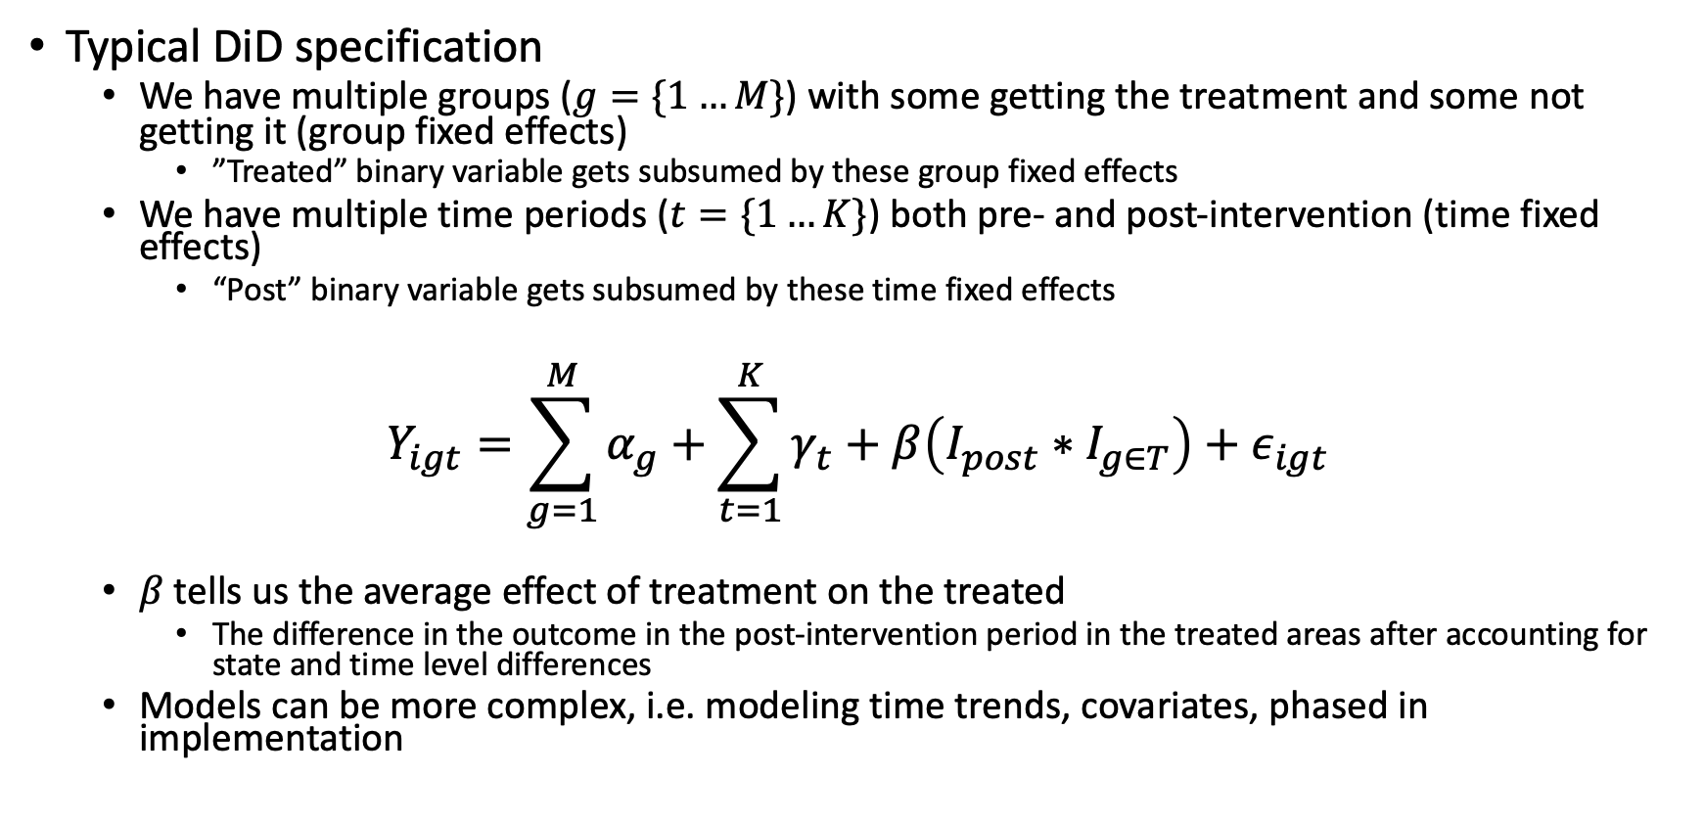
Multiple groups and time periods
Typical DiD specification
We have multiple groups ($g=\{1…M\}$) with some getting the treatment and some not getting it (group fixed effects)
”Treated” binary variable gets subsumed by these group fixed effects
We have multiple time periods ($t=\{1…K\}$) both pre- and post-intervention (time fixed effects)
“Post” binary variable gets subsumed by these time fixed effects
$$Y_{igt}=\sum_{g=1}^{M}{α_{g}}+\sum_{t=1}^{K}{γ_{t}}+β\left(I_{post}∗I_{g∈T}\right)+ε_{igt}$$
$β$ tells us the average effect of treatment on the treated
The difference in the outcome in the post-intervention period in the treated areas after accounting for state and time level differences
Models can be more complex, i.e. modeling time trends, covariates, phased in implementation

Slide 28
Adding covariates
We could adjust the model covariates – without these the model may suffer from omitted variable bias
If the intervention is time varying at the group level, the key omitted variables that affect identification of the effect are time varying group level covariates
Adding individual level covariates may improve fit but is unlikely to effect estimates of program effect
Variation at the group level often captured with group fixed effects
Adding time varying group level covariates potentially has large effect on the estimates
Key question: are there factors that affect the treatment group but not the control group in the post-period? Or vice versa?

Slide 29
Key assumptions: Counterfactual
Key assumption in Difference-in-Differences
Treatment group would have followed the same trajectory as the control group in the post-intervention period if the intervention had not occurred
This counterfactual is not testable
This counterfactual may feel more believable if
Control and treatment areas are qualitatively similar before the intervention
The composition of control and treatment groups are not changing over time in different ways
The control and treatment group are on a similar trajectory before the intervention

Slide 30
Examples
50 states in the US with different policies
States that adopt policy are treatment group, those that do not are control group
Treatment may start at different time in different groups
Examples
Medicaid expansion under the Affordable Care Act
State level rollout of SNAP/benefit programs
State-level rollout of COVID-19 lotteries
State-level rollout of anti-discrimination laws against LGBT discrimination

Slide 31
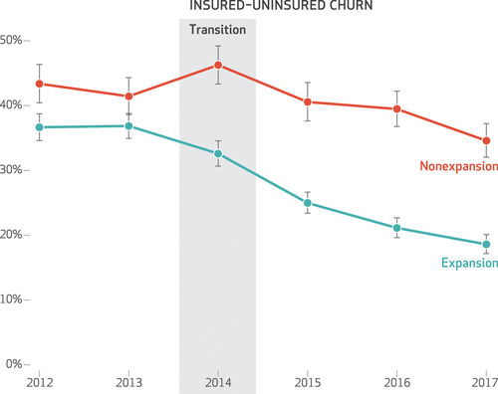
Medicaid Expansion Improved Perinatal Insurance Continuity For Low-Income Women
Daw et al 2020
Question: What is the impact of Medicaid expansion on “churn” (lapses in insurance coverage)
Outcome: transitions from insured to uninsured during pregnancy/postpartum period
Treated: states that expanded Medicaid
Control: states that did not
How convinced are you that the counterfactual assumption is reasonable here?

Slide 32
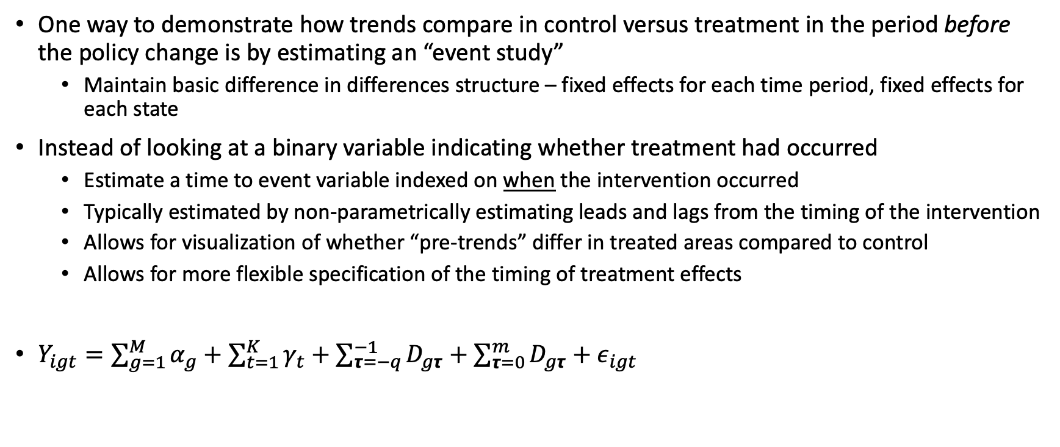
Event study specification
One way to demonstrate how trends compare in control versus treatment in the period before the policy change is by estimating an “event study”
Maintain basic difference in differences structure – fixed effects for each time period, fixed effects for each state
Instead of looking at a binary variable indicating whether treatment had occurred
Estimate a time to event variable indexed on when the intervention occurred
Typically estimated by non-parametrically estimating leads and lags from the timing of the intervention
Allows for visualization of whether “pre-trends” differ in treated areas compared to control
Allows for more flexible specification of the timing of treatment effects
$Y_{igt}=\sum_{g=1}^{M}{α_{g}}+\sum_{t=1}^{K}{γ_{t}}+\sum_{τ=−q}^{−1}{D_{gτ}}+\sum_{τ=0}^{m}{D_{gτ}}+ε_{igt}$

Slide 33
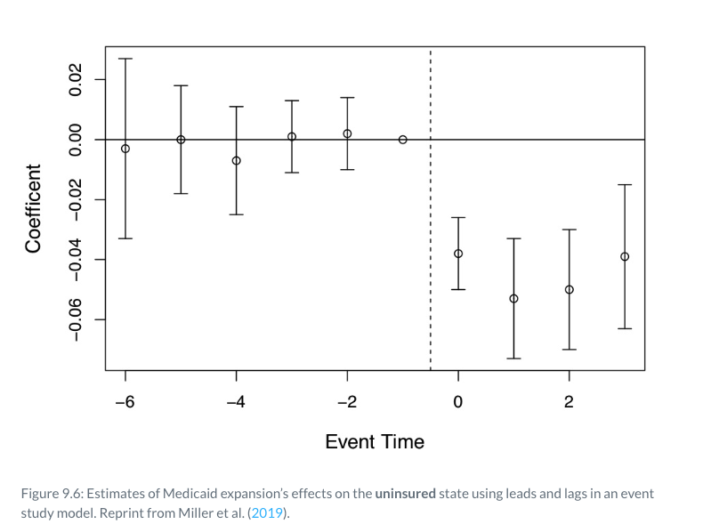
Example
MEDICAID AND MORTALITY: NEW EVIDENCE FROM LINKED SURVEY AND ADMINISTRATIVE DATA
Treated: states that had expanded Medicaid
Control: states that had not expanded Medicaid
Time is indexed to when Medicaid expansion occurred (will be a different year in different states)
Model also includes state, year and survey wave fixed effects
What do we conclude about the impact of Medicaid expansion on prevalence of being uninsured?

Slide 34
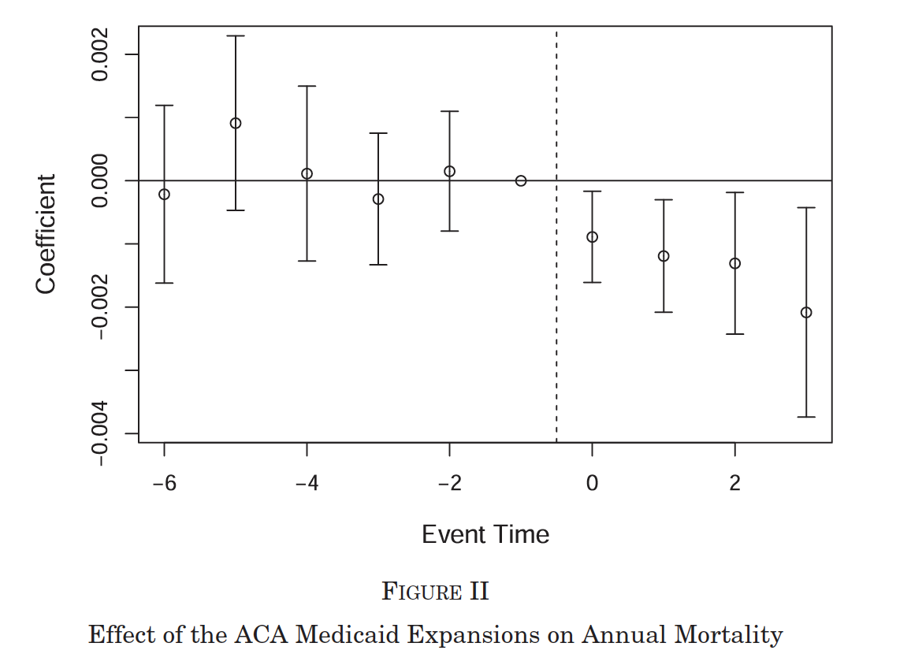
Example
MEDICAID AND MORTALITY: NEW EVIDENCE FROM LINKED SURVEY AND ADMINISTRATIVE DATA
Time is indexed to when Medicaid expansion occurred (will be a different year in different states)
Model also includes state, year and survey wave fixed effects
What do we learn from this figure?
What do you worry about in terms of threats to validity?

Slide 35
Challenge: functional form dependence
Magnitude and sign of the DiD estimator can be sensitive to functional form
DD using level changes
DD using log changes
 | Treatment | Control
Before | 15 | 5
After | 25 | 10
Change | 25 – 15 = 10 | 10 – 5 = 5
DD | 10 – 5 = 5
 | Treatment | Control
Before | log(15) | log(5)
After | log(25) | log(10)
Change | log(25) -log(15) | log(10) – log(5)
DD | -0.182
Adapted from Duflo

Slide 36
Challenge: mean reversion
Often treatments/programs are targeted based on pre-existing differences in outcomes
In fact this may be why some regions are chosen to participate in the program
If outcomes have a natural tendency to mean reversion, comparing outcomes of treated to non-treated regions leads to biased estimates of the treatment effect

Slide 37
Key assumptions: No Contamination
Stable unit treatment value assumption (SUTVA).
We require that "the observation on one unit should be unaffected by the particular assignment of treatments to the other units“
If there is spillover from treatment to control areas due to the intervention this will be violated
What kind of spillovers would you worry about for a study on the impact of Medicaid expansion?
Using US states in health studies
Contamination due to infectious disease spread
Movement of people to get access to policy benefits
Movement of health care providers in policy response

Slide 38
Difference in Difference estimation tips
Show lots of figures
Most reviewers want to see evidence of parallel pre-trends
Event study can be a nice way to show this
Demonstrate no major differential compositional changes in population of treatment or control in post period
Do placebo/falsification tests
Fake time period for policy introduction
Outcome that shouldn’t be affected by treatment
Show impact estimates with and without controls
Controls only need to be group*time varying (all others will fall out of the regression because of group and time fixed effects)
Ideal to control for presence of other programs that might have influenced outcome and show that the impact estimate doesn’t change

Slide 39
Valid standard errors: Clustering
Many difference in difference studies use individual level data to understand group level policy change
Challenge is that outcomes are correlated within groups
One approach is to aggregate data up to the group level and use group level averages to estimate effects like we did in ITS
Will substantially restrict our power
An alternative is to cluster standard errors at the level of treatment, to control for correlation of individuals within the same group
Works well with a large number of clusters

Slide 40
Valid standard errors: Small number of groups
With many groups, clustering the standard errors at the group level works well to allow for intracluster correlation
With a small number of groups, this is not a good approach
Can actually lead to standard errors that are too small
Could instead average the data across groups but this will severely limit power
Can use bootstrap/placebo methods but more complex
“Wild” Bootstrap – use boottest in STATA implements Cameron et al 2008
Construct placebo intervention data based on random assignment of intervention to groups and construct test statistics based on the distribution of outcomes for placebo interventions
Can work with as few as 6 groups

Slide 41
Valid standard errors: Autocorrelation
With autocorrelation, observations for the same group will be correlated over time
Observations of multiple time points pre- and post-intervention will not be independent and do not add much additional information
With a large number of groups, clustering the standard errors across time within the same group can correct for autocorrelation
We can also estimate the autocorrelation structure, but very biased estimates with group fixed effects and small number of periods

Slide 42
Difference-in-Differences vs. Interrupted Time Series
Conceptually similar: both used to estimate the effect of group level interventions by creating a counterfactual; what would have happened without the intervention
Structural differences
ITS uses aggregated data with one treated area time series whereas Difference-in-Differences usually keeps the data at the individual level and adjusts for within-group correlation.
ITS has one treatment group (and one control group in CITS) while Difference-in-Differences works well with multiple treated and control groups
ITS fits a (usually linear) time trend and extrapolates counterfactual whereas Difference-in-Differences uses time fixed effects and uses control group to generate counterfactual
ITS will be favored when change is expected to be immediate and large. DiD methods are better for changes that may be more subtle or phase in over time

Slide 43
Tomorrow we will get into
Recent developments in understanding challenges to differences in differences
Heterogeneity
Challenges with different groups being treated at different times
Current expectations for publishing
Synthetic control methods
Other advanced difference in difference topics
And on Monday we will recap and review all of our econometrics
Bring your questions!

Slide 44
Additional Slides

Slide 45
Formal difference in differences assumptions
Laura Hatfield has created a terrific website that provides a lot of formal detail surrounding difference in differences for health policy:
https://diff.healthpolicydatascience.org/
This website includes simulations you can play around with different assumptions and what they mean
Also contains lots of technical details about the different formal assumptions of DiD

Slide 46
Difference in Difference: Recommended readings
Fry CE, Hatfield LA. Birds of a feather flock together: Comparing controlled pre-post designs. Health Serv Res. 2021 Oct;56(5):942-952.
Causal inference: the Mixtape, Chapter 9
Angrist and Pischke (2009). Mostly Harmless Econometrics, Section 3.2.
Bertrand, Duflo, and Mullainathan (2004). How much should we trust difference-in-differences estimates? [Link]

